Slide 1
Project Lima
Nikita Shaina Patel
Ben Strick
Joshua Roberts
Eric Sun
Xiaowei Sun
Jin Sun
Connor O’Brien

Slide 2
Our Idea
Northwestern-themed Card Game
Two player, turn based strategy mayhem
Multiplayer chat mechanism
Online peer-to-peer gaming action

Slide 3
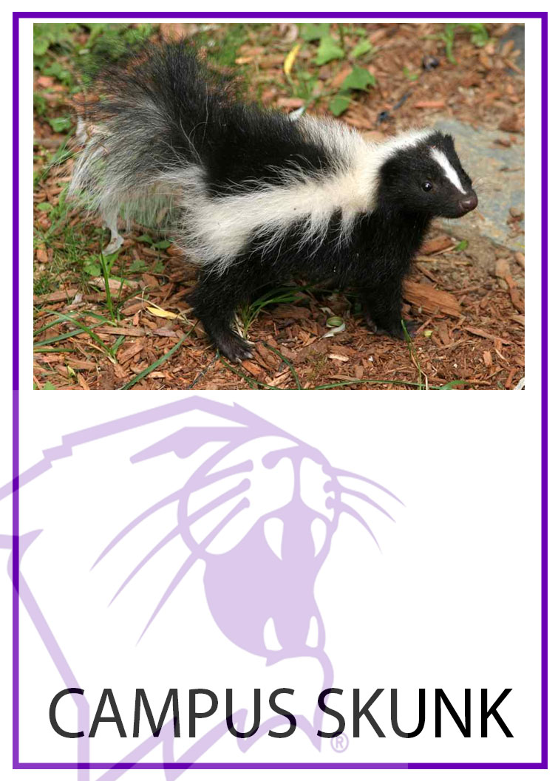

Northwestern-Themed?? A few of our cards…

Slide 4
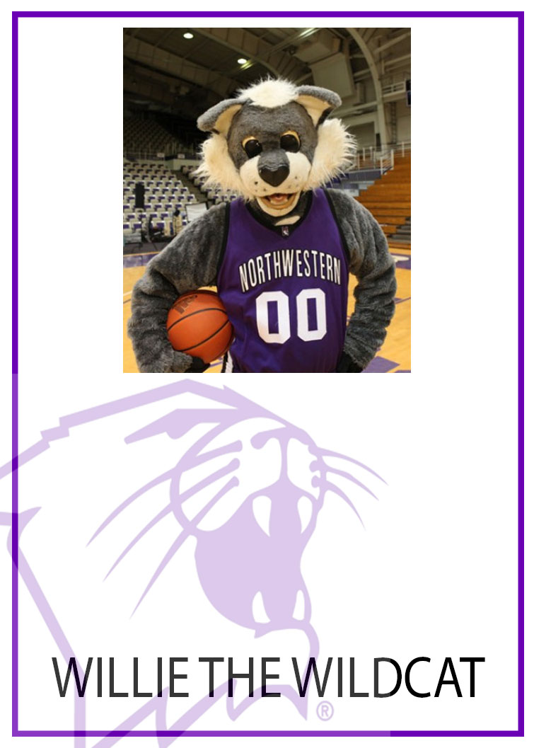
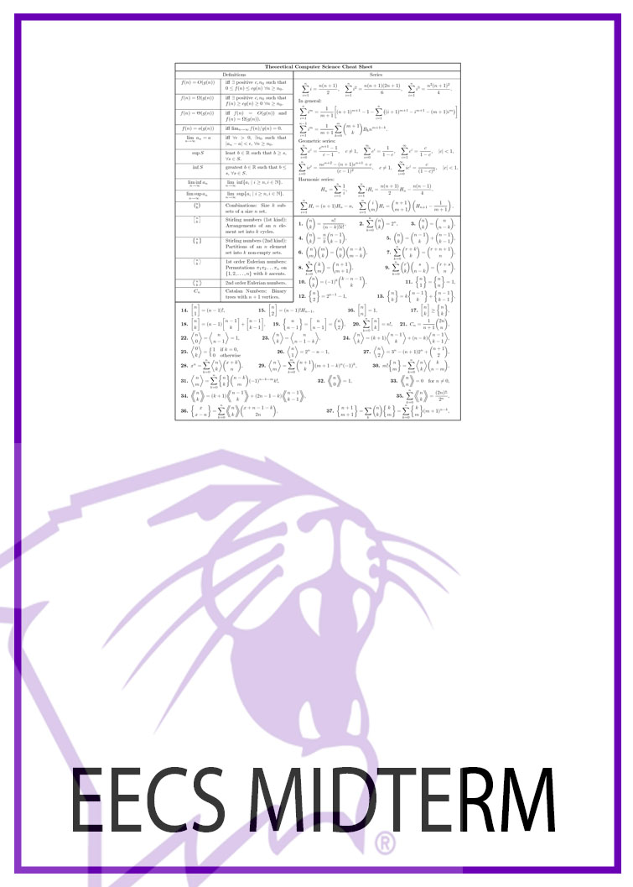
Cards cont.

Slide 5


Cards cont.

Slide 6

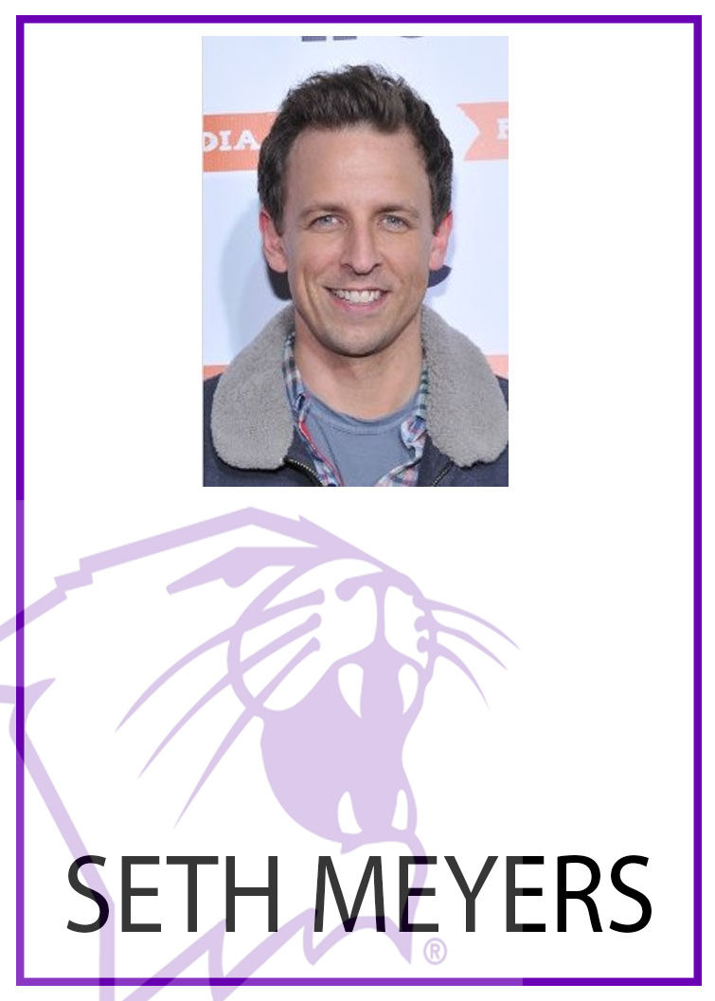
Cards cont.

Slide 7
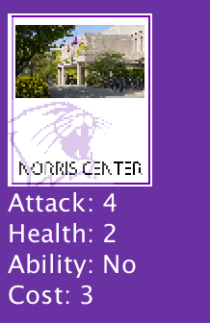
What is a Card?
Cost
Health
Attack
Ability
Description
Name

Slide 8

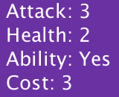
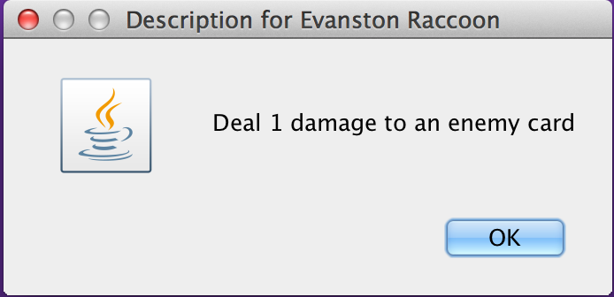
Abilities

